Slide 1
AP Coordination and Full-duplex enabled Multi-band Operation for the Next Generation WLAN: IEEE 802.11be (EHT)
Mao Yang, Bo Li, Zhongjiang Yan, Yuan Yan
School of Electronics and Information
Northwestern Polytechnical University
Xi’an, Shaanxi, China
Speaker: Sheng-Han Chung
Advisor: Kai-Ten Feng, Ph.D, Professor
Institute of Communications Engineering
National Yang Ming Chiao Tung University (NYCU) Hsinchu, Taiwan
July 19th, 2021

Slide 2
Outline
Introduction
Introduction of IEEE 802.11be
AP Coordination Full-duplex Enabled MBO
IEEE 802.11be Device Capability Description
MBO without AP Coordination and Full-duplex enabled MBO
MBO with Full-duplex
MBO with AP Coordination
MBO with AP Coordination and Full-duplex
MAC Framework of AP Coordination and Full-duplex Enabled MBO
Performance Evaluation
Conclusion
References

Slide 3
Outline
Introduction
Introduction of IEEE 802.11be
AP Coordination Full-duplex Enabled MBO
IEEE 802.11be Device Capability Description
MBO without AP Coordination and Full-duplex enabled MBO
MBO with Full-duplex
MBO with AP Coordination
MBO with AP Coordination and Full-duplex
MAC Framework of AP Coordination and Full-duplex Enabled MBO
Performance Evaluation
Conclusion
References

Slide 4
Introduction(1/2)
Wireless local area network (WLAN)
The key objective of IEEE 802.11ax is to significantly improve the network efficiency, so IEEE 802.11ax is also called high efficiency WLAN (HEW).
The key objective of IEEE 802.11be is to extremely improve the maximum throughput of WLAN, so IEEE 802.11be is also called extremely high throughput (EHT) WLAN.
One of the most important technology introduced by IEEE 802.11be is multiband operation (MBO), which enables the APs and STAs to work in multiple frequency bands including 2.4GHz, 5GHz and 6 GHz simultaneously .
multi-band channel bonding (MBCB)
multi-band aggregation (MBA)
multi-band coordination (MBC)

Slide 5
Introduction(2/2)
High-dense deployment is the target scenario of the next generation WLAN.
large number of APs and STAs are deployed in a limited geographical area.
serious interference and collisions if without coordinations among APs.
This paper proposes AP coordination and full-duplex enabled multi-band operation for the IEEE 802.11be.
We propose a MAC framework that fits for all types of device capabilities
MBO only
AP coordination enabled MBO
full-duplex enabled MBO
both AP coordination and full-duplex enabled MBO
The simulation results confirm the performance advantages of proposed MAC framework and show that MBA and MBCB outperform single band scheme in throughput by 200% and 80.7%, respectively

Slide 6
Outline
Introduction
Introduction of IEEE 802.11be
AP Coordination Full-duplex Enabled MBO
IEEE 802.11be Device Capability Description
MBO without AP Coordination and Full-duplex enabled MBO
MBO with Full-duplex
MBO with AP Coordination
MBO with AP Coordination and Full-duplex
MAC Framework of AP Coordination and Full-duplex Enabled MBO
Performance Evaluation
Conclusion
References

Slide 7
Introduction of IEEE 802.11be
Target Scenario of IEEE 802.11be
Technical Objective of IEEE 802.11be
Standardization Roadmap of IEEE 802.11be
Overview of Key Technology of IEEE 802.11be
The physical layer (PHY) capability enhancements (Frequency/Spatial domain)
Multi-band operation (MBO)
Multi-AP coordination
Transmission reliability enhancements
We focus on MBO and try to combine multi-AP coordination as well as full-duplex with MBO to efficiently improve the throughput of IEEE 802.11be.

Slide 8
Outline
Introduction
Introduction of IEEE 802.11be
AP Coordination Full-duplex Enabled MBO
IEEE 802.11be Device Capability Description
MBO without AP Coordination and Full-duplex enabled MBO
MBO with Full-duplex
MBO with AP Coordination
MBO with AP Coordination and Full-duplex
MAC Framework of AP Coordination and Full-duplex Enabled MBO
Performance Evaluation
Conclusion
References

Slide 9
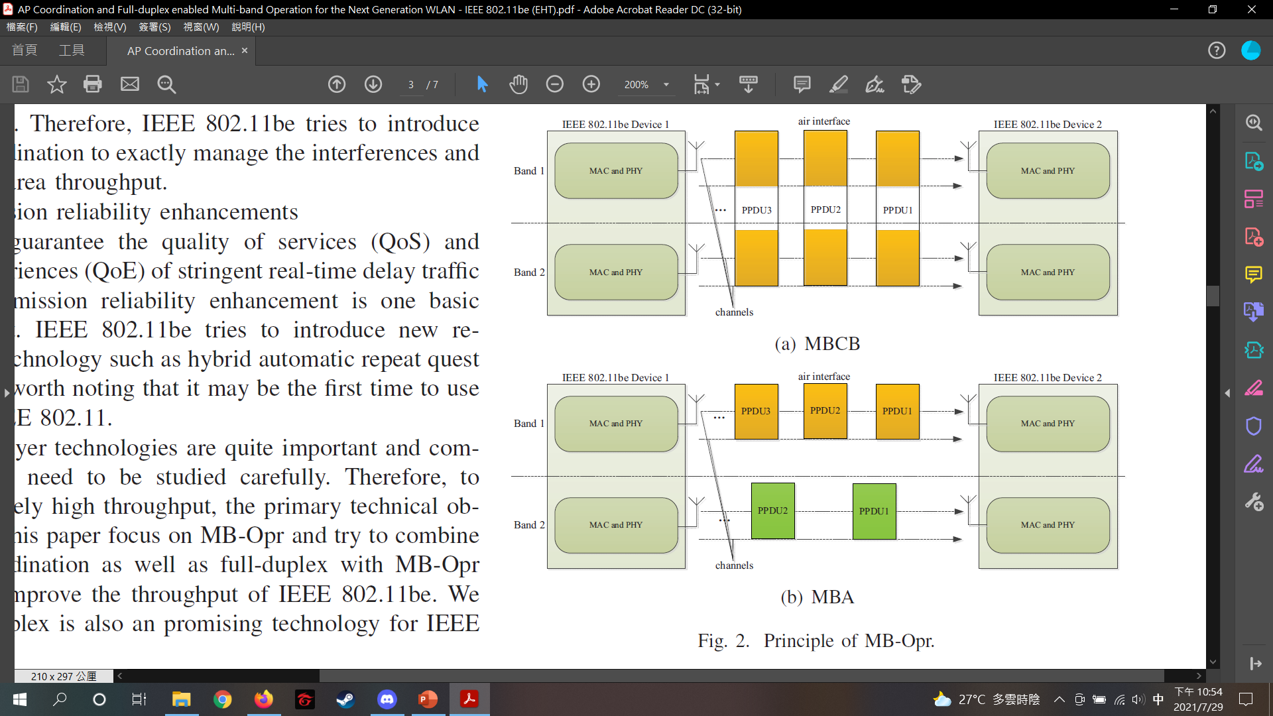
AP Coordination Full-duplex Enabled MBO (1/3)
IEEE 802.11be Device Capability Description
Considering cost and complexity, different devices have different capabilities, and thus different MAC processes are required.
MBO without AP Coordination and Full-duplex enabled MBO
MBCB: allowed to bond channels from different bands.
Such as 80MHz + 80MHz.
MBA : transmit and receive PPDUs in multiple bands independently.
Devices send PPDUs in each band rather than constructing one unified PPDU
by bonding multi-band.

Slide 10
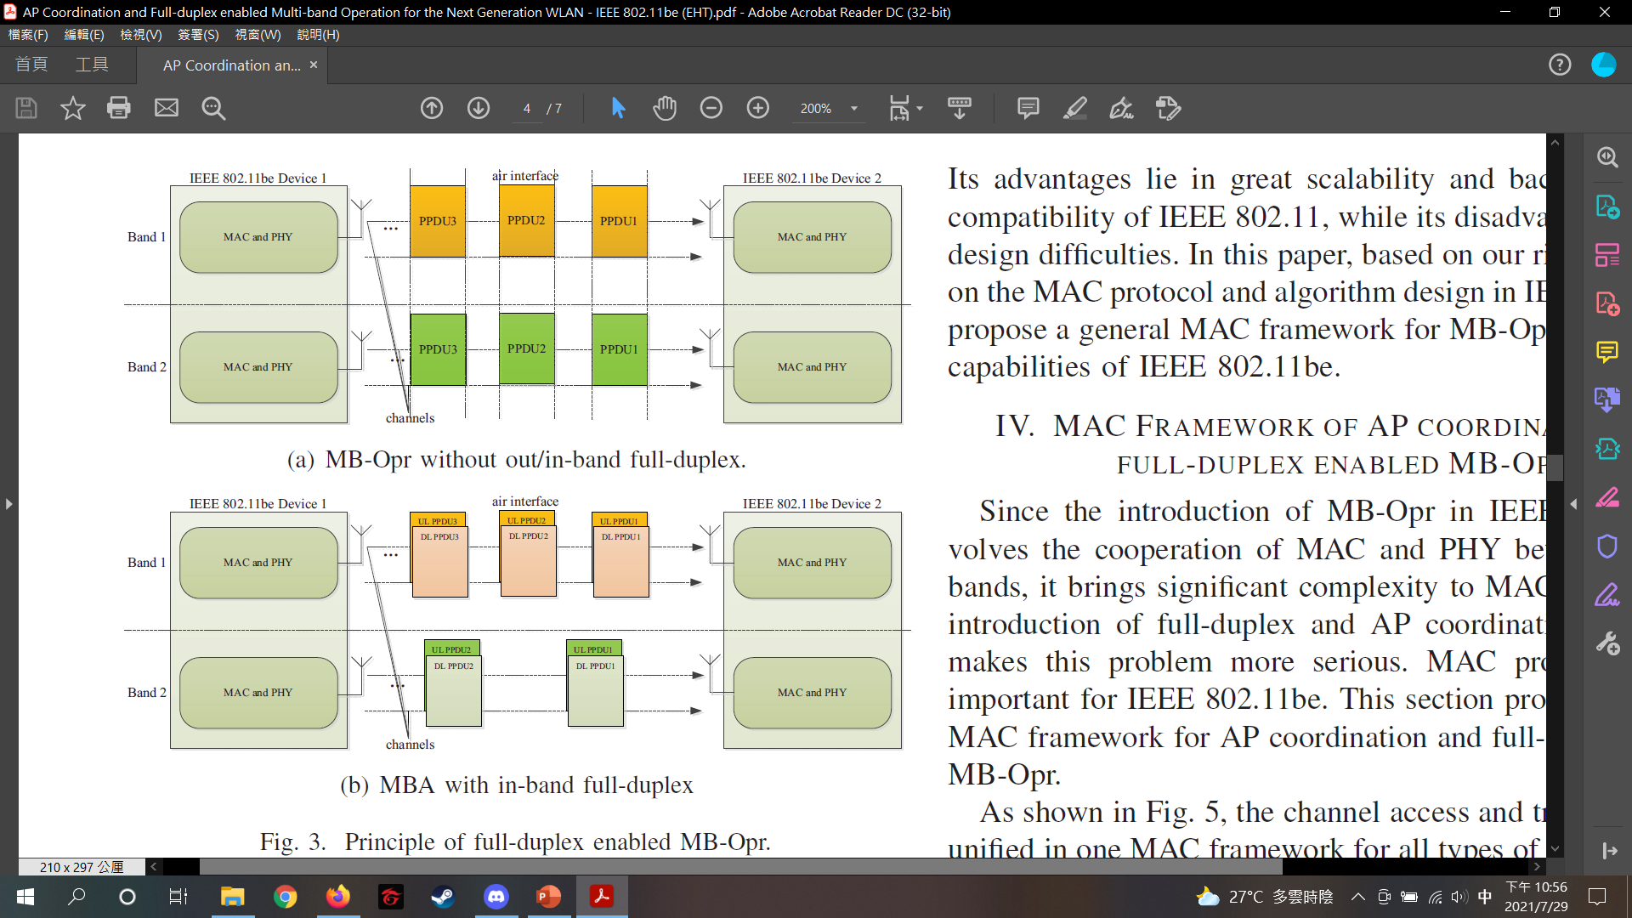
AP Coordination Full-duplex Enabled MBO (2/3)
MBO with Full-duplex
Out-of-band full-duplex.
Two adjacent frequency bands can perform MBA independently.
Multiple bands are sent or received simultaneously.
In-band full-duplex
Devices have the in-band full-duplex capability, APs and STAs can transmit and receive simultaneously in each band.
Whether out-of-band full-duplex or in-band full-duplex, the MBCB is always applicable.

Slide 11
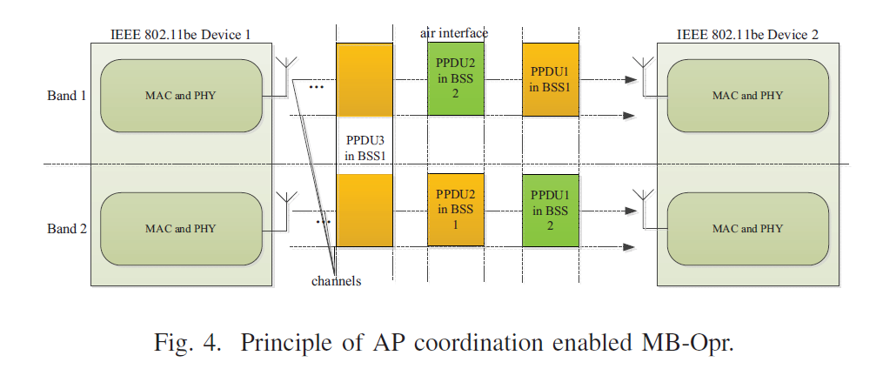
AP Coordination Full-duplex Enabled MBO (3/3)
MBO with AP Coordination
During each transmission opportunity, multiple APs could coordinate with each other to optimize scheduling and multi-band resource allocation in order to obtain the better area throughput.
MBO with AP Coordination and Full-duplex
Obtain both advantages of full-duplex and AP coordination, and also further brings greater flexibility.
Requires the highest cost and implementation complexity.

Slide 12
Outline
Introduction
Introduction of IEEE 802.11be
AP Coordination Full-duplex Enabled MBO
IEEE 802.11be Device Capability Description
MBO without AP Coordination and Full-duplex enabled MBO
MBO with Full-duplex
MBO with AP Coordination
MBO with AP Coordination and Full-duplex
MAC Framework of AP Coordination and Full-duplex Enabled MBO
Performance Evaluation
Conclusion
References

Slide 13
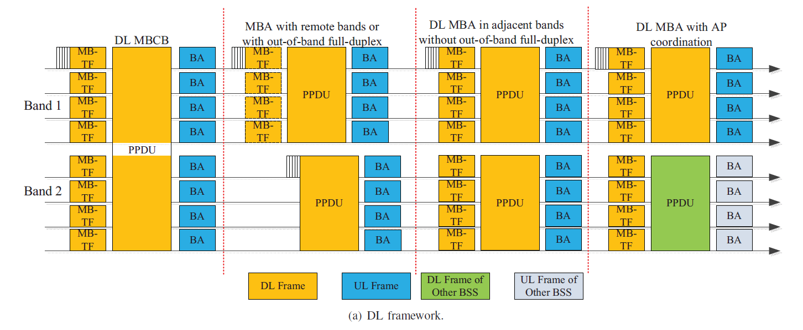
MAC Framework of AP Coordination and Full-duplex Enabled MBO (1/2)
Downlink (DL) process
DL MBCB.
MBA with remote bands or with out-of-band full-duplex.
DL MBA in adjacent bands without out-of-band full-duplex.
DL MBA with AP coordination.

Slide 14
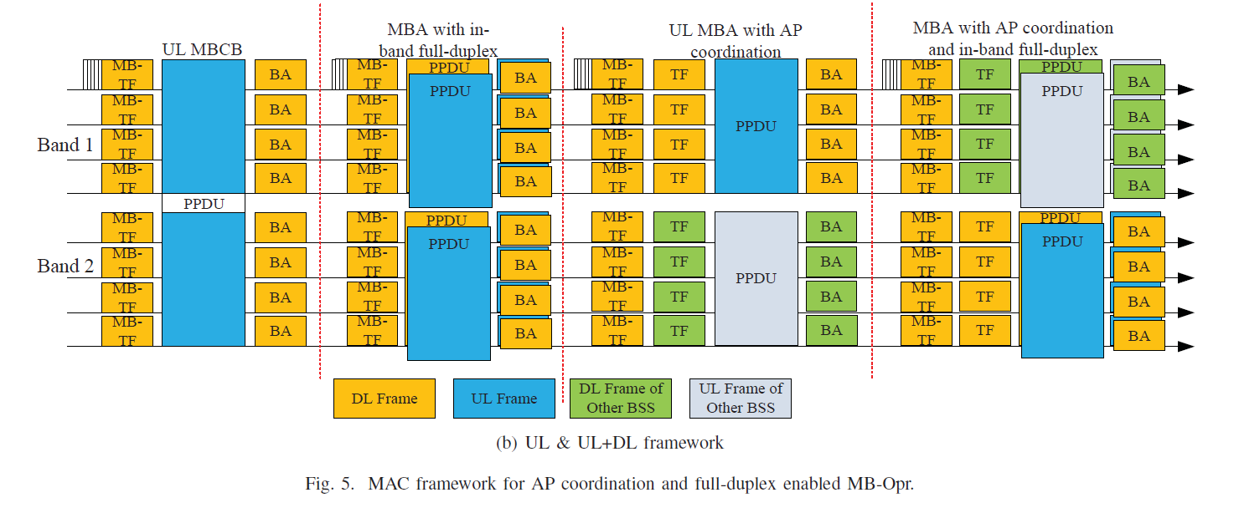
MAC Framework of AP Coordination and Full-duplex Enabled MBO (2/2)
UL and UL+DL process
UL MBCB.
MBA with in-band full-duplex.
UL MBA with AP coordination.
UL MBA with AP coordination and in-band full-duplex.

Slide 15
Outline
Introduction
Introduction of IEEE 802.11be
AP Coordination Full-duplex Enabled MBO
IEEE 802.11be Device Capability Description
MBO without AP Coordination and Full-duplex enabled MBO
MBO with Full-duplex
MBO with AP Coordination
MBO with AP Coordination and Full-duplex
MAC Framework of AP Coordination and Full-duplex Enabled MBO
Performance Evaluation
Conclusion
References

Slide 16
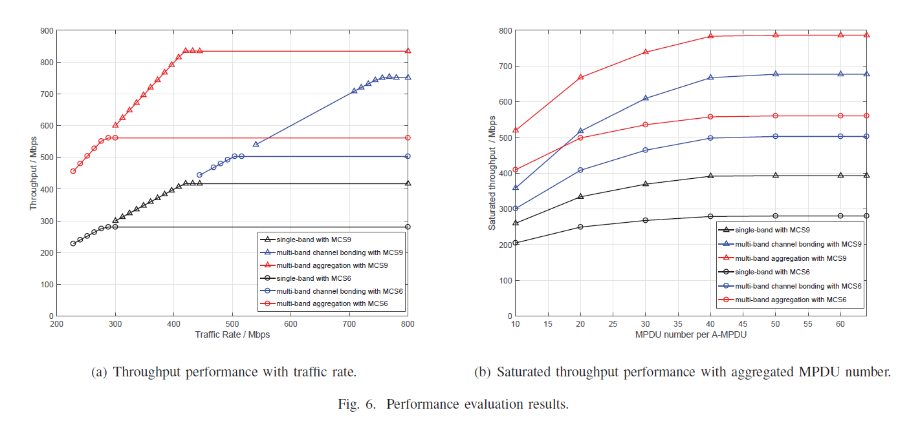
Performance Evaluation
Throughput performance varying with traffic rate.
Saturated throughput performance varying with aggregated MPDU number.
Single band、MBCB、MBA

Slide 17
Outline
Introduction
Introduction of IEEE 802.11be
AP Coordination Full-duplex Enabled MBO
IEEE 802.11be Device Capability Description
MBO without AP Coordination and Full-duplex enabled MBO
MBO with Full-duplex
MBO with AP Coordination
MBO with AP Coordination and Full-duplex
MAC Framework of AP Coordination and Full-duplex Enabled MBO
Performance Evaluation
Conclusion
References

Slide 18
Conclusion
Ultra-high definition video traffic is the key feature of future wireless networks which requires extremely high throughput of the next generation WLAN.
MBO is one of the most important features of IEEE 802.11be to achieve the objective of extremely high throughput.
This paper introduces AP coordination and full-duplex to MBO, analyzes the possible schemes, and proposes a MAC framework of AP coordination and full-duplex enabled MBO.
It has high scalability and backward and forward compatibility.
The simulation results show that the performance of proposed MAC frame work and confirm that MBA and MBCB outperform single band scheme in throughput by 200% and 80.7%, respectively.
The future work includes the technical detail designs of the MAC protocol, and the scheduling algorithm.

Slide 19
Outline
Introduction
Introduction of IEEE 802.11be
AP Coordination Full-duplex Enabled MBO
IEEE 802.11be Device Capability Description
MBO without AP Coordination and Full-duplex enabled MBO
MBO with Full-duplex
MBO with AP Coordination
MBO with AP Coordination and Full-duplex
MAC Framework of AP Coordination and Full-duplex Enabled MBO
Performance Evaluation
Conclusion
References

Slide 20
References
[1] M. Yang, B. Li, Z. Yan and Y. Yan, "AP Coordination and Full-duplex enabled Multi-band Operation for the Next Generation WLAN: IEEE 802.11be (EHT)," 2019 11th International Conference on Wireless Communications and Signal Processing (WCSP), 2019, pp. 1-7, doi: 10.1109/WCSP.2019.8928021.

